Slide 1


BlendIn
Your Passport to Local Culture
Join us in helping newcomers feel at home faster. Let's blend in together.

Slide 2


We Are
BlendIn simplifies cultural integration for tourists, immigrants and international students through personalized, interactive learning about local customs, language, and norms.
Notes:
Talk a bit about Founder/Market Fit

Slide 3
The Problem
Cultural Barriers: Tourists, immigrants, and students face cultural and linguistic challenges that lead to isolation and missed opportunities.
Language Barriers: Ineffective communication impacts daily life and professional growth.
Social Isolation: Poor cultural understanding complicates social networking and integration.
Inadequate Resources: Current cultural learning tools are outdated, impersonal, and slow to assist in adaptation.

Slide 4
Existing Solution
Our Solution
A Digital Platforms: Offer superficial insights with no customization or structured learning pathways.
A Personalized Learning: Tailors content to individual cultural and linguistic needs for more effective integration.
B Language Classes and Workshops: Focus mainly on broad language skills, neglecting everyday slang and cultural contexts.
B Interactive Platform: Combines depth with interactive learning and structured paths that adjust to user progress.
C Community Groups: Provide community comfort but can isolate members from broader local cultural integration.
C All-in-One Resource: Consolidates all cultural learning needs in one place, streamlining access and learning.
Notes:
. Personalized Learning
Tailors content to individual cultural and linguistic needs for more effective integration.
Example: Customized modules on American sports, slang, or local traditions.
Consultants focus

Slide 5
Create Our Unique
A
B
Personalized content tailored to user's background, interests, and preferences
C
User-friendly design with interactive features
Focuses on practical, everyday nuances

Slide 6
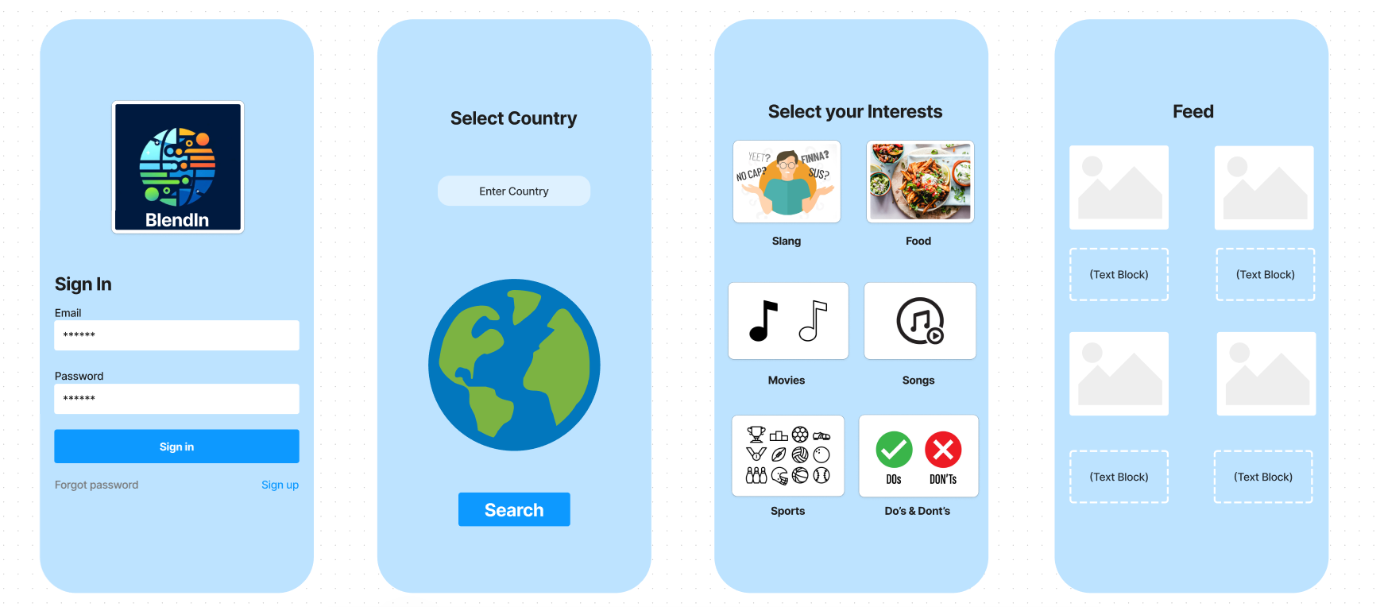

Preview

Slide 7

Business Model
A
Subscription Model: Offer a freemium model with basic access for free and premium tiers for advanced features like personalized coaching and exclusive community access.
B
Advertising and Sponsorships: Generate revenue through targeted ads from businesses like relocation services and cultural events that appeal to immigrants and expatriates.
C
Partnerships and Affiliates: Collaborate with educational institutions, corporations, and government bodies to offer tailored cultural integration programs and resources.

Slide 8








Competition
Culture Oriented
Language Oriented
Social Media forums and Blogs

Slide 9
Market Overview
TAM
Total Available Market
Migrants and tourists
1.4 Billion
Serviceable Available Market
SAM
287 Million
Key destination countries
Serviceable Obtainable Market
SOM
Initial Capture Rate
1.4 Million

Slide 10
Market Overview
Country | Immigrants(Millions)
US | 50.6
Germany | 15.8
Saudi Arabia | 14
Russia | 12
UK | 9.4
UAE | 8.7
France | 8.5
21% millennials relocate every year for new jobs.
6.4 million students migrate every year for education. This number increases by 12% every year.
Data reported by Organization for economic cooperation and development.

Slide 11

Thank you
Team BlendIn
Yogesh Napanda
Pratham Prabhu
Vishesh Anand
Yatharth Bajaj

